Slide 1
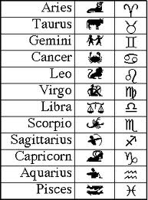
The zodiac signs.

Slide 2
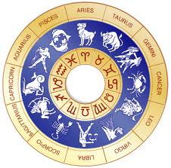
These are the 12 signs of the zodiac.
I am the scorpion

Slide 3
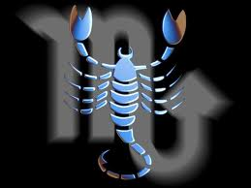
This is scorpio, my zodiac.

Slide 4
About scorpio:
Element: water
Planet: Pluto
Symbol: the scorpion
Stone: topaz
Description: Reputed to be the "most powerful" sign of the zodiac, Scorpios lead fate filled lives and have intense and dramatic personal relationships. Even as children Scorpios are often found to be wise beyond their years. Many astrologers call this the sign of the "oldest souls". Old and wise beyond the average, Scorpios often know all the answers, except sometimes; they too often have difficulty finding what they need to develop their own happiness.

Slide 5
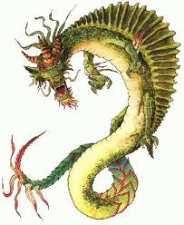
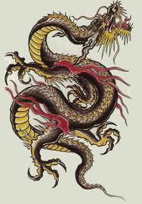
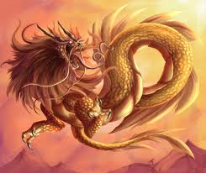
We are in the year of the dragon

Slide 6
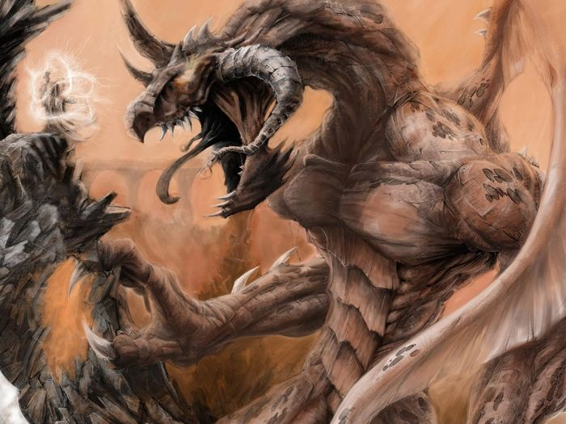
About dragons
Dragons are legendary creatures.
Dragons can have wings and they can breath fire
Dragons are reptiles, they have tails and arms and legs.

Slide 7
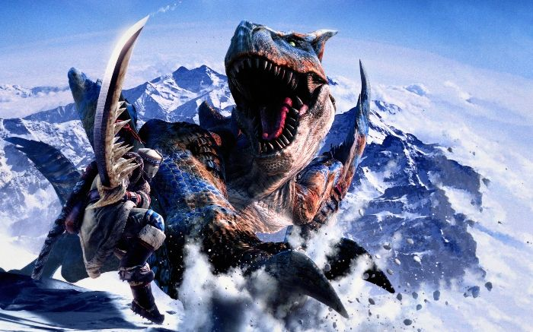
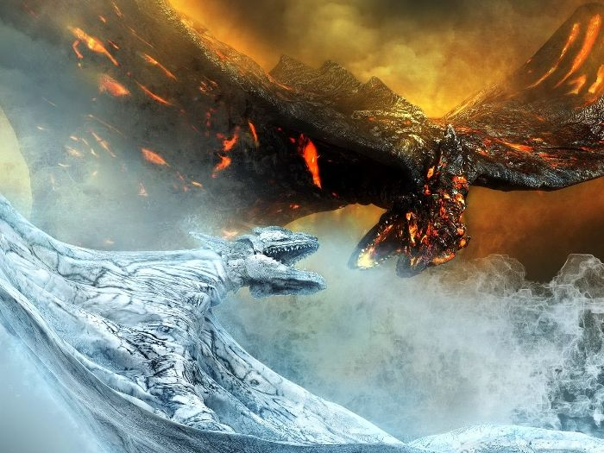
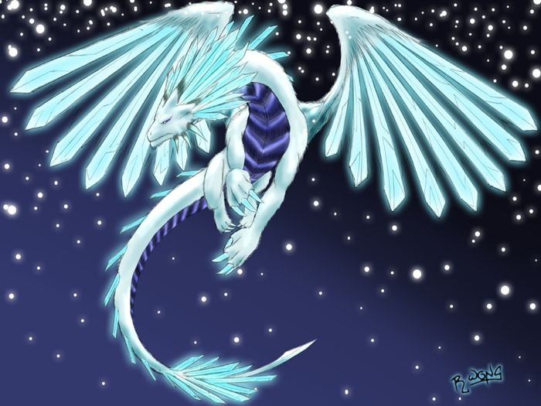
Dragon pics

Slide 8
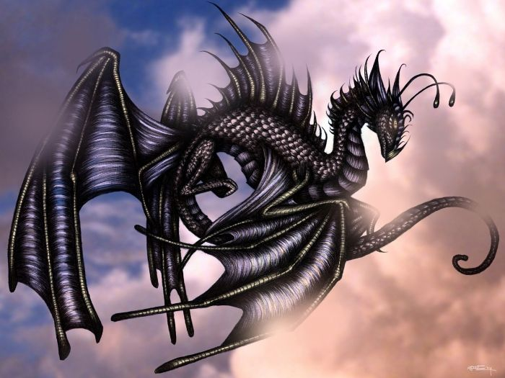
The end.

